Slide 1
Energy, ATP and Respiration
Br Adam
Chapter 3

Slide 2
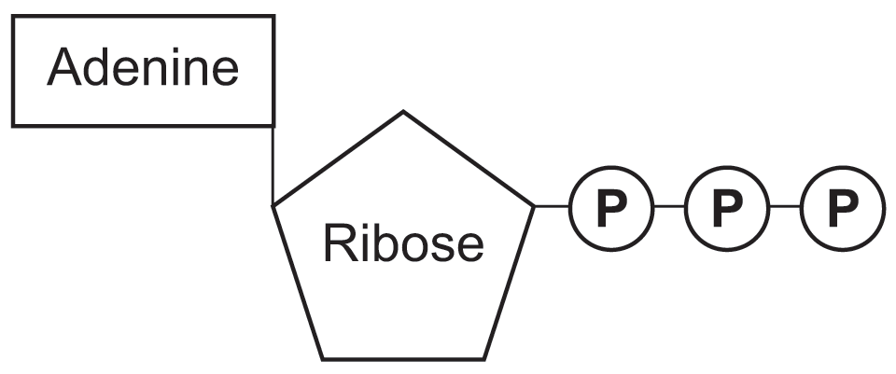
Energy and ATP
ATP is a nucleotide consisting of an organic base, adenine, a five carbon sugar (ribose) and a sequence of three phosphate groups

Slide 3
Energy and ATP
ATP is often called the universal energy currency in living organisms as it provides a common source of energy for many different chemical reactions.

Slide 4
Energy and ATP
Living organisms use the gradual release of energy in small steps to produce ATP
ADP is converted to ATP by the addition of a phosphate molecule

Slide 5
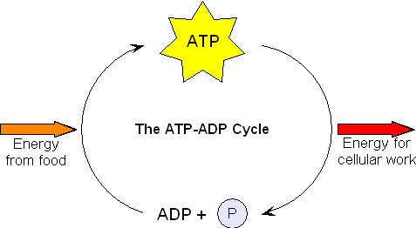
Energy and ATP
This requires 30kJmol⁻¹ of energy from food
This releases 30kJmol⁻¹ of energy for use in the body
This is called
PHOSPHORYLATION
This is called HYDROLYSIS. Via. Enzyme ATPase
Endergonic
(energy taken in)
Exergonic
(energy released)

Slide 6
Phosphorylation
Adding an inorganic phosphate (P_{i}) to ADP to create ATP
Three forms

Slide 7
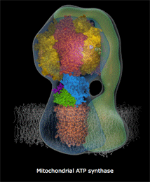
Phosphorylation
OXIDATIVE PHOSPHORYLATION
Occurs on the membrane of the mitochondria during aerobic respiration and involves the process of the electron transport chain

Slide 8
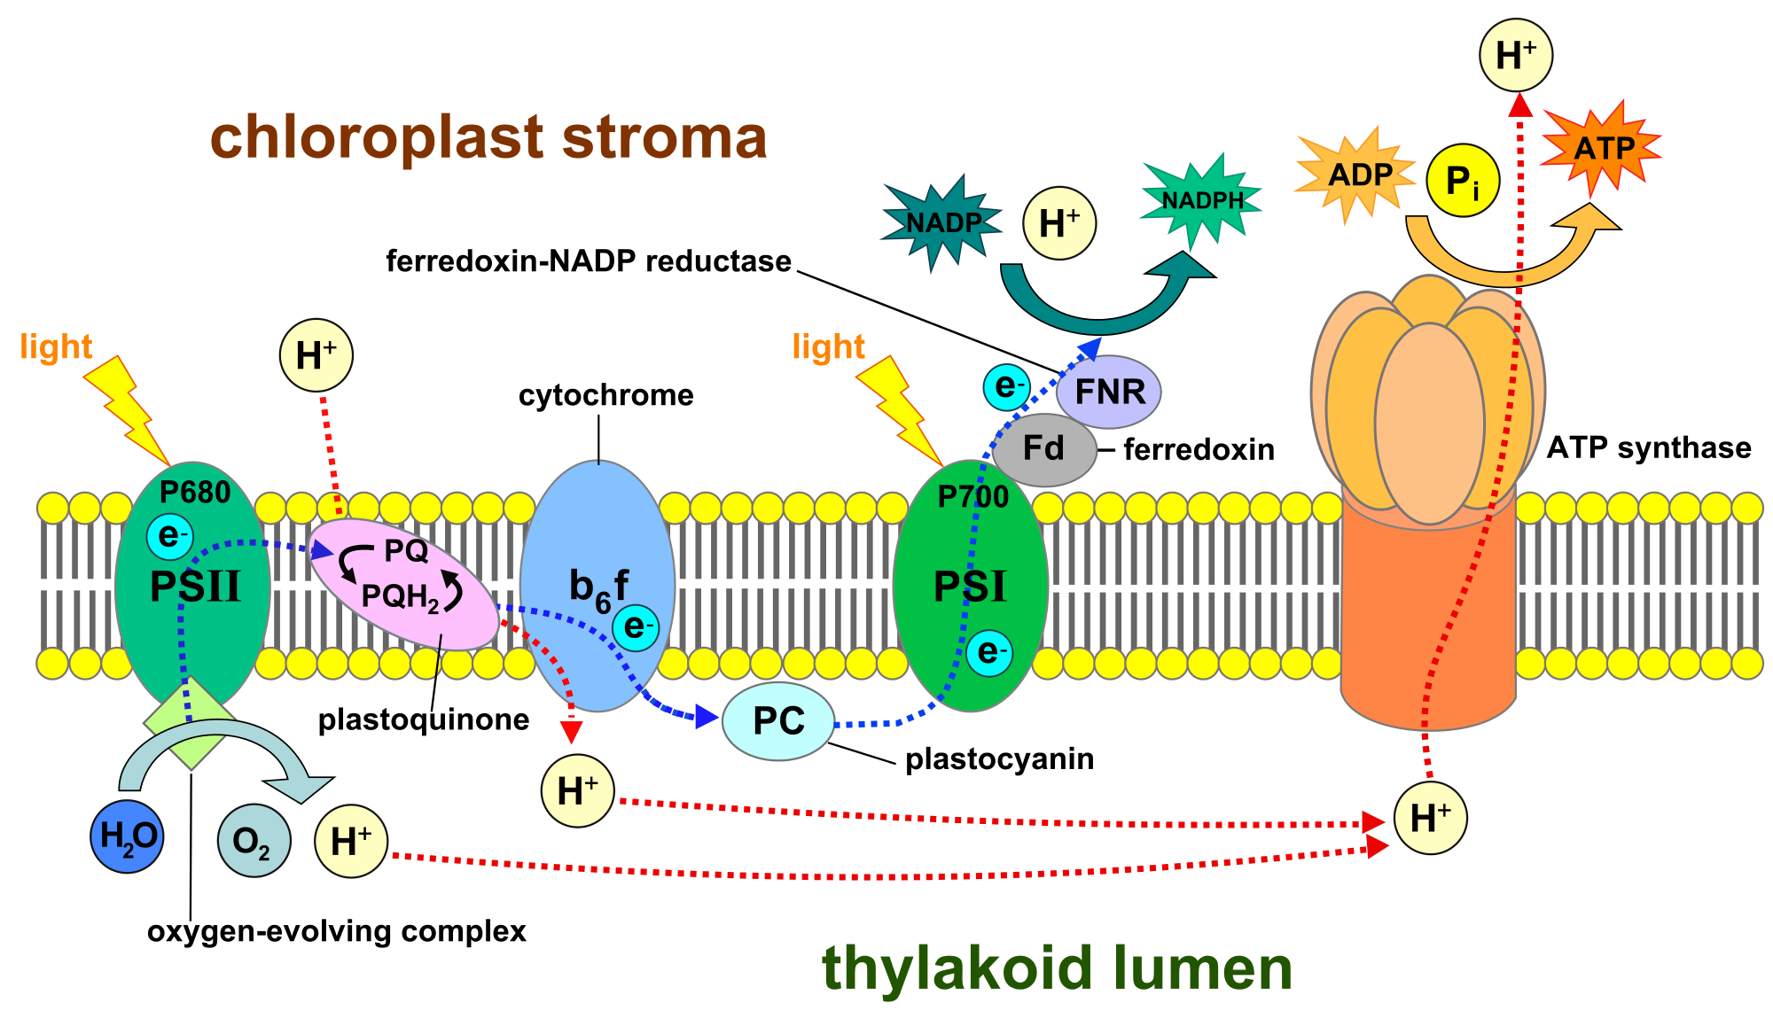
Phosphorylation
2)PHOTOPHOSPHORYLATION
Occurs in the thylakoid membranes in the chloroplasts in PLANTS only

Slide 9
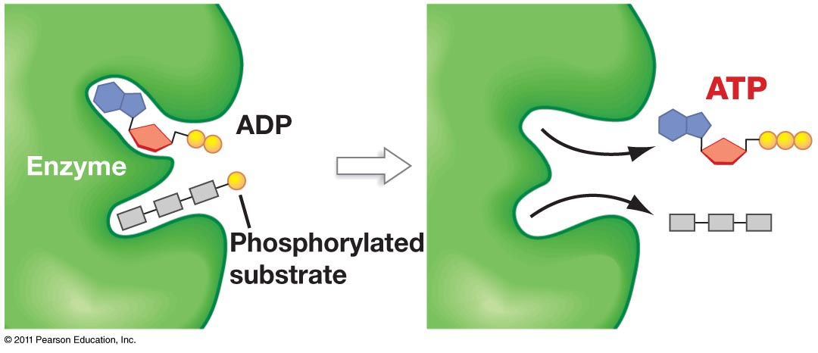
Phosphorylation
3)SUBSTRATE-LEVEL PHOSPHORYLATION
Occurs when phosphate groups are transferred from donor molecules to ADP to make ATP for example in Glycolysis

Slide 10
Advantages of ATP
Only one enzyme needed to release energy from ATP (ATPase) Glucose needs more
ATP released energy in small amounts when and where needed, whereas glucose contains large amounts we don’t need straight away
ATP is a common source of energy for a multitude of chemical reactions, increasing the efficiency of the cells in the body. (International energy currency)

Slide 11
What is ATP used for?
Metabolic Processes – Building large complex molecules from smaller, simpler molecules. For example ATP is required in DNA and Protein synthesis
Active Transport – ATP can change the shape of carrier proteins in plasma membranes to allow molecules/ions to be moved against the concentration gradient.
Movement – For muscle contraction
Nerve Transmission – Na+/K+ Active Transport Pumps require ATP
Synthesis of materials within Cells
Secretion – The packaging and transport of secretory products into vesicles in cells

Slide 12
Respiration
4 main stages...
Glycolysis
The Link Reaction
The Krebs Cycle
The Electron Transport Chain

Slide 13
1. Glycolysis
Glucose
Location: Cytoplasm
Glucose-6-Phosphate
Glucose-6-Phosphate
Glucose-6-Phosphate
1st Phosphorylation
H⁺ taken to reduce NAD
Glucose-6-Phosphate
PYRUVIC ACID
Glucose-6-Phosphate
2 x ATP
H⁺ taken to reduce NAD
1st Phosphorylation
Isomerisation
Triose Phosphate
2 x ATP
PYRUVIC ACID
Fructose-6-Phosphate
The glucose molecule is obtained as the digested product of eating carbohydrates
Triose Phosphate
The glucose molecule is obtained as the digested product of eating carbohydrates
The glucose molecule is obtained as the digested product of eating carbohydrates
The glucose molecule is obtained as the digested product of eating carbohydrates
1st Phosphorylation
2nd Phosphorylation
Fructose-1-6 Bisphosphate
The glucose molecule is obtained as the digested product of eating carbohydrates
1st Phosphorylation
The glucose molecule is obtained as the digested product of eating carbohydrates
The glucose molecule is obtained as the digested product of eating carbohydrates
The glucose molecule is obtained as the digested product of eating carbohydrates
The glucose molecule is obtained as the digested product of eating carbohydrates
The glucose molecule is obtained as the digested product of eating carbohydrates
They are then converted into pyruvic acid. This involves the removal of hydrogen and it’s transfer to a hydrogen carrier molecule (NAD) to form reduced NAD. Each pyruvic acid yields 2 molecules of ATP in the process of it’s creation
This is then phosphorylated for a second time, splitting a molecule of ATP, forming fructose-1-6-bisphosphate
The fructose-1-6-bisphosphate then splits into two molecules called TRIOSE PHOSPHATE.
They each have 3 carbons and 1 phosphate
The glucose molecule is obtained as the digested product of eating carbohydrates
The glucose is phosphorylated into glucose-6-phosphate by taking a phosphate from ATP
The glucose-6-phosphate changes to fructose-6-phosphate via isomerisation

Slide 14
Glycolysis- Summary
Breaking down a glucose molecule into two molecules of pyruvate (pyruvic acid)
It uses 2 ATP molecules for substrate level phosphorylation
It creates 4 ATP molecules
There is a NET TOTAL of 2 ATP molecules made.
The 2 reduced NAD made goes to the electron transport chain
The 2 molecules of pyruvate go into the link reaction

Slide 15
Glycolysis- Summary
Process | Glycolysis | The Link Reaction | The Krebs Cycle
Number of ATP used (per glucose) | 2
Number of ATP produced (pg) | 4
Net Total ATP (pg) | 2
Number of reduced NAD produced (pg) | 2
Number of reduced FAD produced (pg) | 0
Other products made (pg) | 2 molecules of pyruvic acid

Slide 16
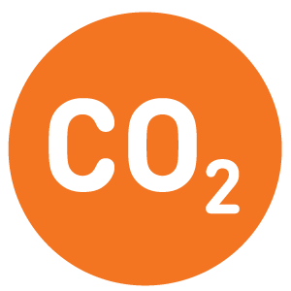
2. The Link Reaction
Location:
Mitochondrion Matrix
From Glycolysis
To Krebs Cycle
DECARBOXYLASE
ACETATE
2C
PYRUVIC ACID (3C)
Acetyl coA
The link reaction connects Glycolysis to the Krebs cycle
The link reaction connects Glycolysis to the Krebs cycle
The link reaction connects Glycolysis to the Krebs cycle
The link reaction connects Glycolysis to the Krebs cycle
DEHYDROGENASE
H+ to reduce NAD
The link reaction connects Glycolysis to the Krebs cycle
The link reaction connects Glycolysis to the Krebs cycle
The link reaction connects Glycolysis to the Krebs cycle
The link reaction connects Glycolysis to the Krebs cycle
The link reaction connects Glycolysis to the Krebs cycle
This forms acetate, which is taken up by coenzyme A (coA) recycled from the Krebs cycle to form acetyl coA
The pyruvic acid diffuses into the mitochondrial matrix
This is decarboxylated via decarboxylase to produce CO₂ and dehydrogenated via dehydrogenase to produce H⁺ , used to reduced a molecule of NAD
This is taken into the krebs cycle

Slide 17
The Link Reaction- Summary
Process | Glycolysis | The Link Reaction | The Krebs Cycle
Number of ATP used (per glucose) | 2 | 0
Number of ATP produced (pg) | 4 | 0
Net Total ATP (pg) | 2 | 0
Number of reduced NAD produced (pg) | 2 | 2
Number of reduced FAD produced (pg) | 0 | 0
Other products made (pg) | 2 molecules of pyruvic acid | 2 x Carbon Dioxide 2 x Acetyl coA

Slide 18
3. The Krebs Cycle
Citric Acid
6C
Location:
Mitochondrion Matrix
Citric Acid
6C
Citric Acid
6C
Citric Acid
6C
Acetyl coA
2C
Citric Acid
6C
H+ to reduce NAD
Citric Acid
6C
DEHYDROGENASE
Oxaloacetic Acid
4C
DECARBOXYLASE
Keto-Glutaric Acid
5C
H+ to reduce
NAD
Acetyl coA
2C
Acetyl coA
2C
Acetyl coA
2C
1 x ATP
Acetyl coA
2C
DEHYDROGENASE
H+ to reduce FAD
DEHYDROGENASE
DECARBOXYLASE
Malic Acid
4C
DEHYDROGENASE
Succinic Acid
4C
H+ to reduce NAD
The function of the Krebs cycle is a means of liberating energy from carbon bonds to provide ATP, r.NAD and r.FAD , with the release of carbon dioxide
The Oxaloacetic acid is regenerated from malic acid by a final dehydrogenation, reducing NAD
Acetyl coA enters the Krebs Cycle by combining with a 4C acid to form a 6C compound.
The Acetyl is regenerated and recycle back into the link reaction
The 6C Compound (citric acid) undergoes decarboxylation and dehydrogenation to produce CO₂ and H+ ion, this is used to reduce an NAD. These processes produced a 5C compound
This 4C compound is then dehydrogenated again. This H+ ion emitted is used to reduce FAD
This 5C compound is then decarboxylated and dehydrogenated again, producing a 4C Compound. This produced enough energy to synthesise the production of 1 ATP Molecule

Slide 19
The Krebs Cycle- summary
Per cycle we obtain…
1 ATP
3 r.NAD
1 r.FAD
2 Carbon Dioxide Molecules
Remember that the Krebs Cycle turns twice per glucose molecule.

Slide 20
The Krebs Cycle -Summary
Process | Glycolysis | The Link Reaction | The Krebs Cycle
Number of ATP used (per glucose) | 2 | 0 | 0
Number of ATP produced (pg) | 4 | 0 | 2
Net Total ATP (pg) | 2 | 0 | 2
Number of reduced NAD produced (pg) | 2 | 2 | 6
Number of reduced FAD produced (pg) | 0 | 0 | 2
Other products made (pg) | 2 molecules of pyruvic acid | 2 x Carbon Dioxide 2 x Acetyl coA | 4 x Carbon Dioxide

Slide 21
4. The Electron Transport Chain
A series of carriers and pumps, releasing energy in the form of ATP

Slide 22
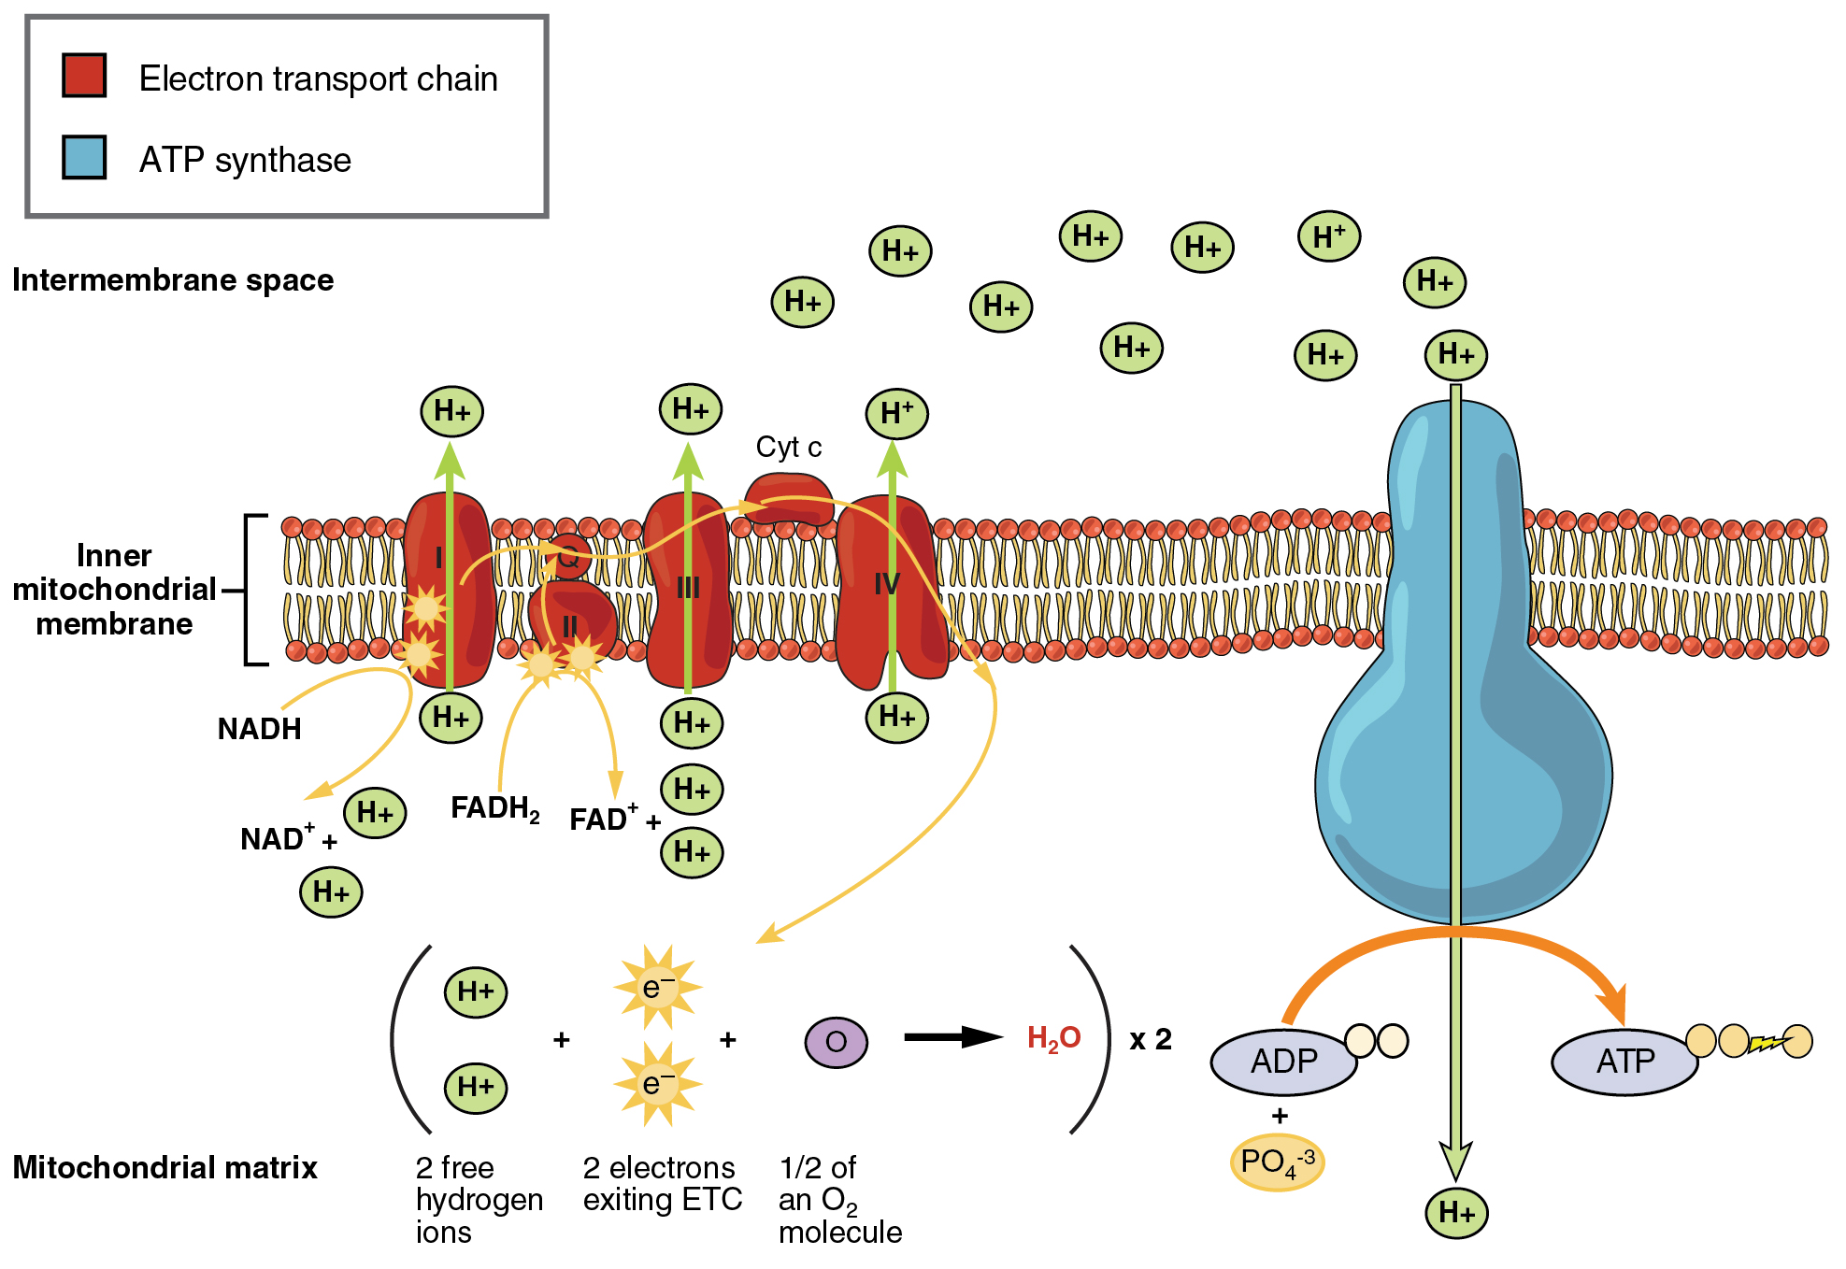
4. The Electron Transport Chain

Slide 23
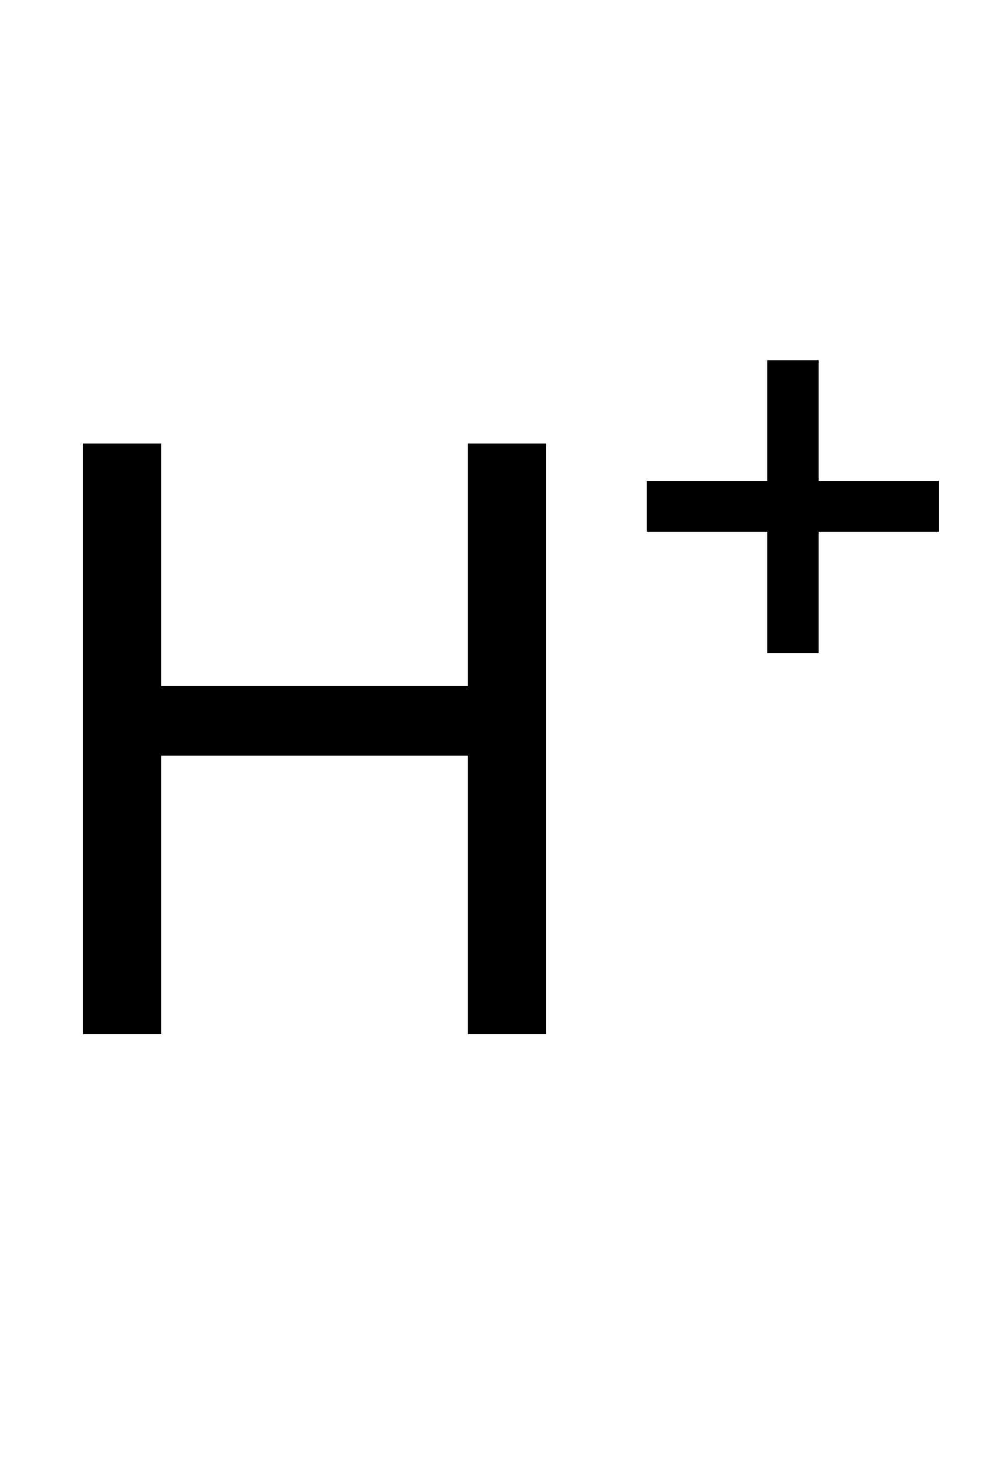
4. The Electron Transport Chain
High Concentration of H+ ions
Inter membrane space
- The pump is pumping them from the matrix, they are taking them from reduced NAD and FAD
ATP
PUMP
PUMP
PUMP
Concentration Gradient is Set Up!
ATP SYNTHETASE
ATP
Low Concentration of H+ ions is maintained
-When they pass through ATP synthetase they combing with oxygen and electrons to form water.
Matrix

Slide 24
Chemiosmotic Theory
r.NAD/r.FAD donate their hydrogen to the first pump
The pump becomes takes them up and pumps them into intermembrane space
An electron with a slightly reduced energy level is transferred through the pumps
A high concentration of protons build up in the intermembrane space as the membrane is impermeable to protons.
The protons are able to flow back via ATP Synthetase
When they they flow through this, ATP is created
The electron that had been transferred now combines with the proton and oxygen to form water in the matrix, this maintains the conc. Gradient (catalysed by oxidase)

Slide 25
Energy Budget
Process | Glycolysis | The Link Reaction | The Krebs Cycle
Number of ATP used (per glucose) | 2 | 0 | 0
Number of ATP produced (pg) | 4 | 0 | 2
Net Total ATP (pg) | 2 | 0 | 2
Number of reduced NAD produced (pg) | 2 | 2 | 6
Number of reduced FAD produced (pg) | 0 | 0 | 2
Other products made (pg) | 2 molecules of pyruvic acid | 2 x Carbon Dioxide 2 x Acetyl coA | 4 x Carbon Dioxide

Slide 26
Energy Budget
Altogether, per molecule of glucose, we obtain
4 ATP
10 r.NAD
2 r.FAD
Each reduce FAD is capable of making 2 ATP in the electron transport chain
x 3 = 30 ATP
x 2 = 4 ATP
Each reduce NAD is capable of making 3 ATP in the electron transport chain
Altogether, per glucose molecule, 38 ATP are made

Slide 27
Anaerobic Respiration
In the absence of oxygen only glycolysis can take place
The rNAD/rFAD cannot be reoxidised and therefore able to pick up more hydrogen so the link reaction and krebs can’t occur
The yield of ATP is only 2

Slide 28
Anaerobic Respiration
During vigorous exercise the human body has to respire anaerobically
This involves glycolysis , but the reduced NAD produced passes it’s protons straight to pyruvic acid, reducing it to lactic acid
A build up of lactate can cause muscle cramp. When oxygen becomes available it is broken down by the liver. Most is converted to glycogen and stored.

Slide 29
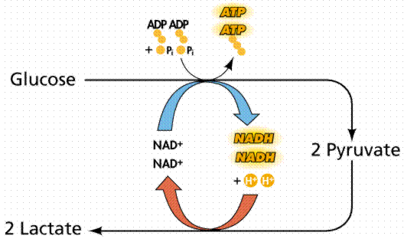
Anaerobic Respiration

Slide 30
Fermentation
Takes place in yeast where the pyruvate is converted into alcohol and carbon dioxide
The pyruvate is first decarboxylated to produce ethanal
The hydrogen released during glycolysis is passed to NAD
Reduced NAD passes its hydrogen to ethanal, reducing it to ethanol

Slide 31
Alternative Respiratory Substances
Lipids
Fat provides an energy store and is useful when carb levels are low
It has to first be hydrolysed into glycerol and fatty acids
The glycerol is converted into a 3C sugar and enter glycolysis via triose phosphate
The fatty acids are split up into many 2C fragments which enter pathway as acetyl CoA
This is why one gram of fat releases twice as much energy than carbohydrate

Slide 32
Alternative Respiratory Substances
Proteins
Only used when in starvation mode
Protein is hydrolysed producing amino acids
Then deaminated in the liver, amine group converted to urea and urinated out
Residues are converted into acetyl CoA, Pyruvate or some other Krebs Cycle intermediate.
Protein only used when carb and fat stores are depleted

